Slide 1
Comparison Between Disk Scheduling Algorithms
Presented by:
Bola Nader(202000645)
Kerolos salama(202001113)
Aya Elneanaei Fouda (202002609)
Lina Eyad(202000202)

Slide 2
Introduction
Operating systems use disc scheduling as a method of determining which I/O request will be handled first. Disc scheduling algorithms aim to increase throughput while reducing reaction times. In the current piece of research, 9 distinct disc scheduling methods are compared and analyzed.
Researchers are focusing their efforts on improving traditional disc scheduling algorithms including FCFS, SSTF, SCAN, C-SCAN, LOOK, and C-LOOK. According to our research we will focus on three new algorithms (IFCFS, SMCC and HDSA).

Slide 3
FCFS SSTF
FCFS is the simplest algorithm and performs operations in the order in which requests are received. It does not provide the fastest service. Also, no rearranging of requests is performed. In the first come first serve disk scheduling algorithm the request that arrives first is served first.
Disadvantages:
Since this scheduling strategy is non-preemptive, the process cannot be halted mid-execution and must complete its whole course.
The algorithm selects the request that is closest to the current position of the disk head, reducing the average seek time and improving disk throughput.
Disadvantages:
The method becomes slower when the Head's direction changes frequently.

Slide 4
SCAN C-SCAN
In the SCAN disk scheduling algorithm, the head begins at one end of the disc and advances to the other, serving requests one by one until it reaches the other end.
Disadvantages:
Even when there are no requests to be served, the head moves all the way to the end of the disc in SCAN.
Similar to SCAN (Elevator Algorithm), C-SCAN moves the head from one end to the other end while servicing all requests.
Disadvantages:
In contrast to the SCAN algorithm, in C-SCAN the Head will continue to move to the end of the disc even if there are no more requests to be handled.

Slide 5
LOOK C-LOOK
The LOOK algorithm handles requests similarly to the SCAN method, but it also "looks" ahead as if there are additional tracks in the same direction that need to be served.
Disadvantages:
The cylinders that Head has just visited have to wait a long time
Then it reverses the direction immediately without going all the way to the end of the disk.
Disadvantages:
There is a cost associated with finding the end requests in C-LOOK.

Slide 6
New algorithm IFCFS
The disc head is moved by IFCFS to satisfy the initial I/O request. If there are any requests waiting from the current disc head position to the first request, they will be served on the way to serving the first request. The disc head will shift to the next request in the queue after serving the initial request and any requests that were served along the way. If there are any requests waiting from the current disc head position to the next waiting request, they will be serviced along the way.

Slide 7
New algorithm HDSA
First, the service request queue is divided into two new queues P and Q. The first queue P contains requests that are lower than the initial disk head position h; while the second queue Q contains requests that are greater than initial disk head position h. Next, the absolute difference between h and the lowest track request n of disk queue P and absolute difference between h and the highest track request m of disk queue Q, are calculated as x and y respectively. If x > y, then scanning begins in disk request queue Q, servicing the requests using SSTF, then serves the requests in queue P using SSTF as well. Otherwise, if x < y then disk request queue P takes the lead, and servicing operations begin immediately on the other request queue Q after P has been completed.

Slide 8
New algorithm SMCC
The algorithm begins by sorting the requests in ascending order, and then extracts the midway request from the sorted queue. The algorithm then compares the current head pointer against the request for the midpoint. If the current head pointer is less than the midpoint request, the algorithm will service each request starting with the first and ending with the last in the sorted list. Otherwise, it will serve the requests from the last request until we reach the first request in the sorted list. Finally, we will calculate the total number of head movement and average seek time.

Slide 9
Methodology
We have written the code of all nine algorithms mentioned above in c++ programming language. Next, we ran the program on six cases randomly. The program serviced them and calculated the total seek time according to each of the algorithms. Finally, we compared the results between all algorithms in all six cases in terms of total seek time.

Slide 10
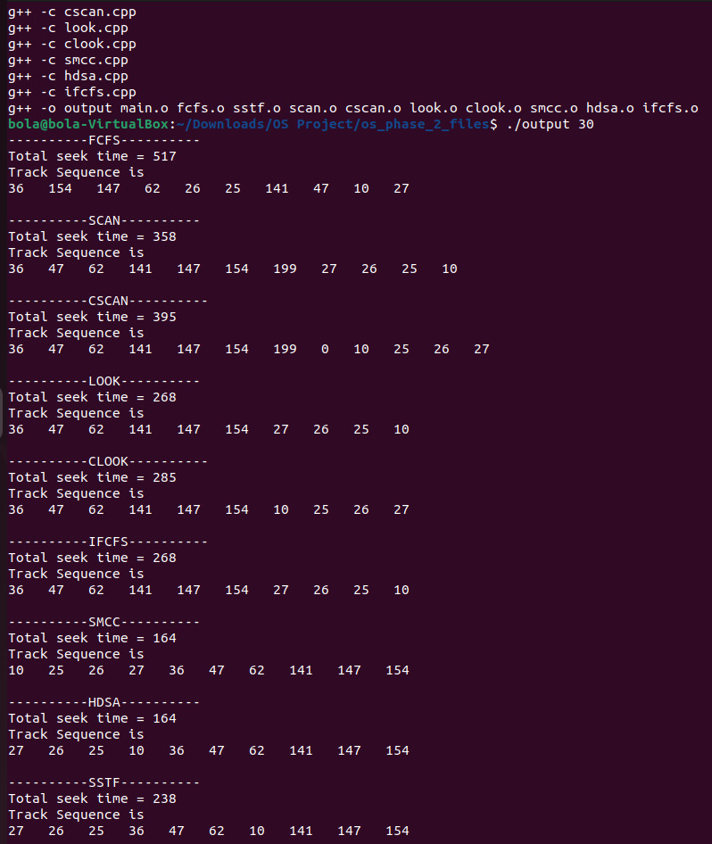
Output sample

Slide 11
Case 1
Suppose a disk drive has 200 cylinders, numbered 0 to 199. Consider a disk queue with requests for i/o to blocks on cylinder: 101, 67, 50, 95, 160, 159, 152, 16, 102, 23. Assume that disk head is currently at cylinder 50. The figures below show the representation of FCFS, SSTF, SSTF, SCAN, C-SCAN, LOOK, C-LOOK, IFCFS, SMCC and HDSA disk scheduling algorithm

Slide 12
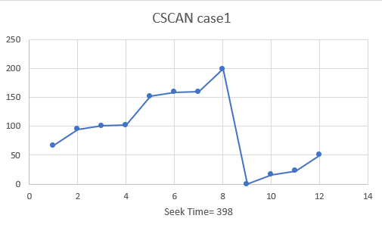
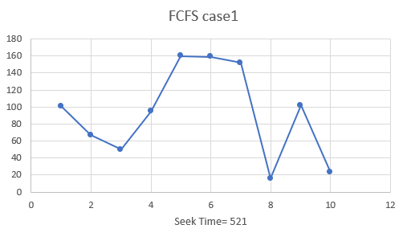
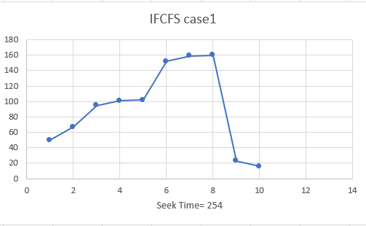
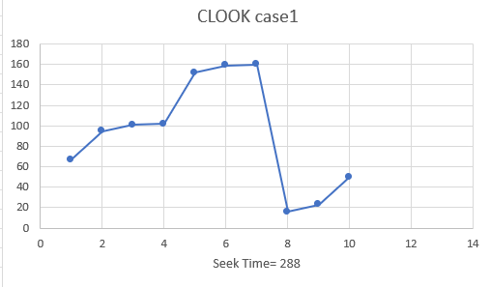
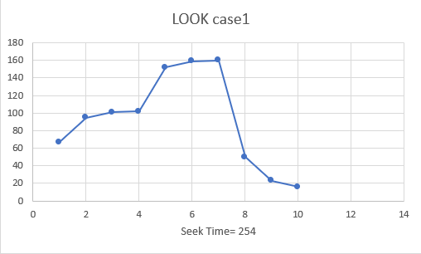
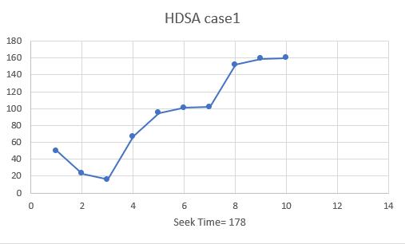
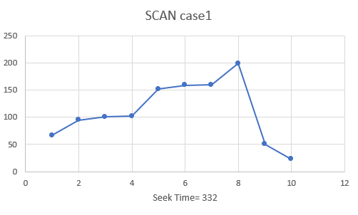
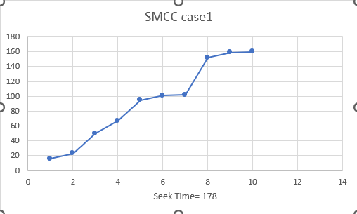
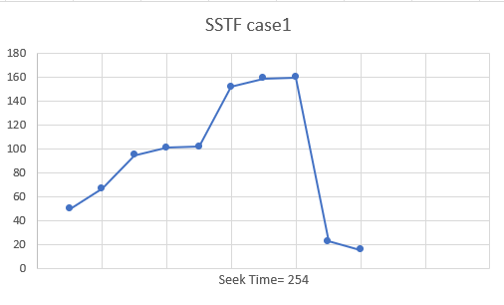

Slide 13
Case 2
Suppose a disk drive has 200 cylinders, numbered 0 to 199. Consider a disk queue with requests for i/o to blocks on cylinder:36, 154, 147, 62, 26, 25, 141, 47, 10, 27. Assume that disk head is currently at cylinder 30. The figures below show the representation of FCFS, SSTF, SSTF, SCAN, C-SCAN, LOOK, C-LOOK, IFCFS, SMCC and HDSA disk scheduling algorithm.

Slide 14
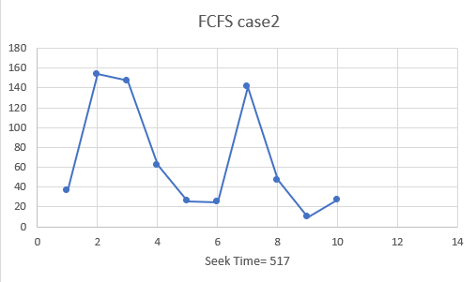
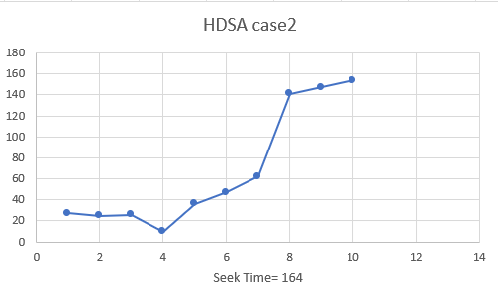
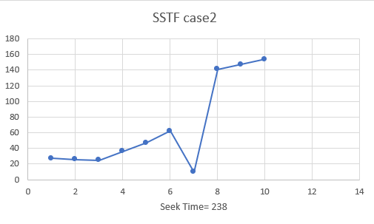
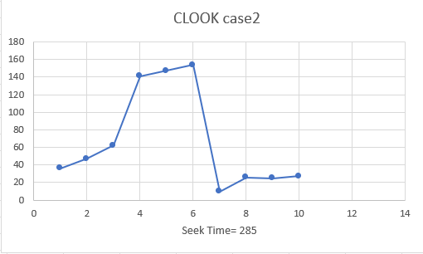
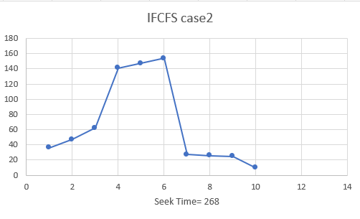
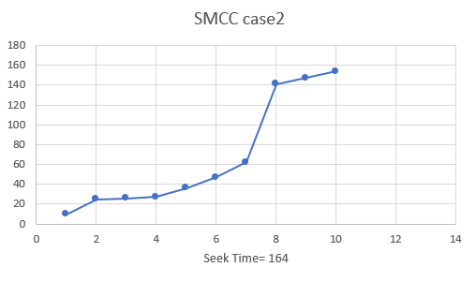
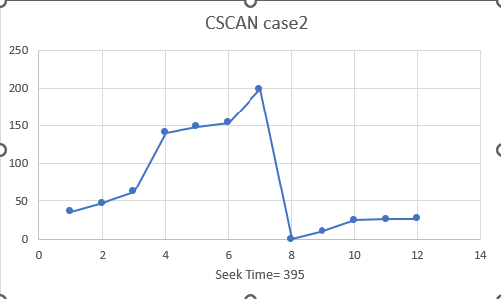
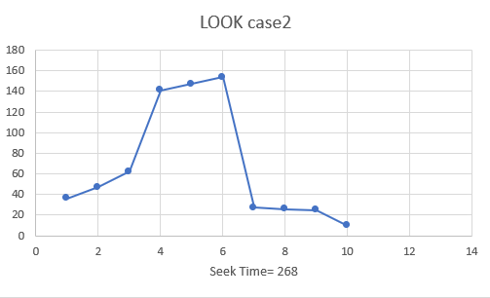
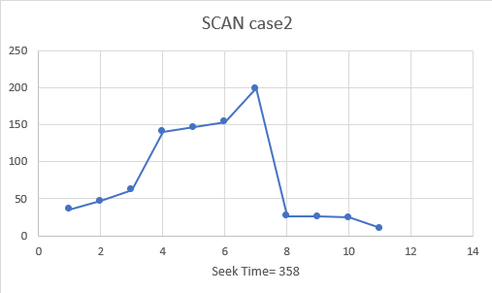

Slide 15
Case 3
Suppose a disk drive has 200 cylinders, numbered 0 to 199. Consider a disk queue with requests for I/o to blocks on cylinder: 2, 130, 21, 44, 104, 197, 50, 98, 13, 31. Assume that disk head is currently at cylinder 66. The figures below show the representation of FCFS, SSTF, SSTF, SCAN, C-SCAN, LOOK, C-LOOK, IFCFS, SMCC and HDSA disk scheduling algorithm

Slide 16
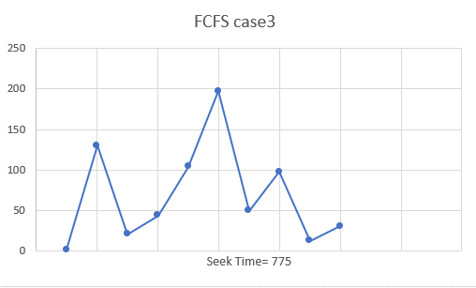
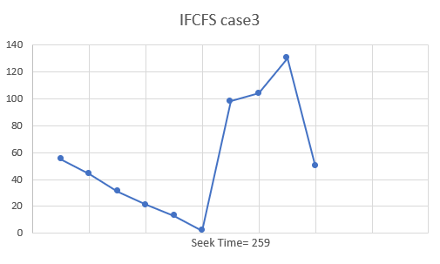
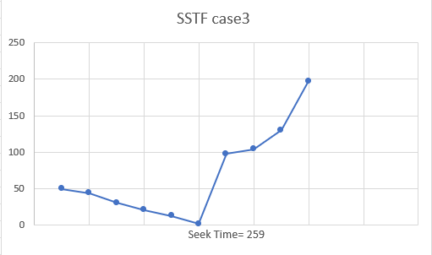
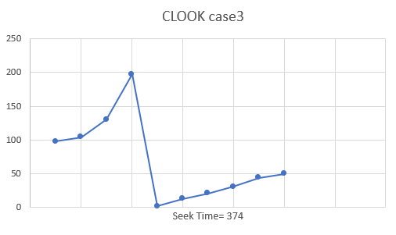
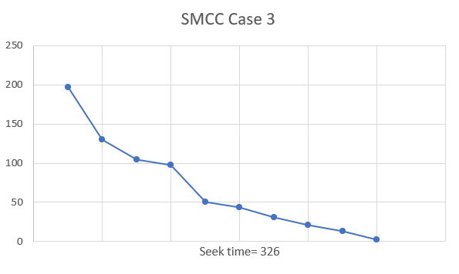
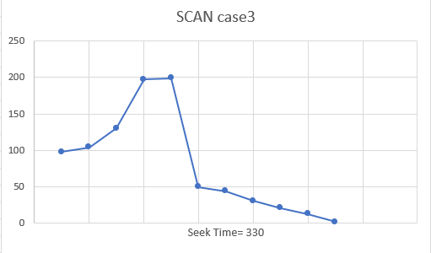
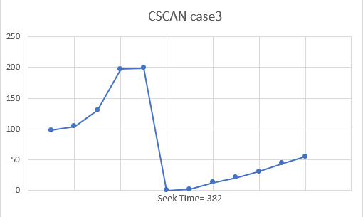
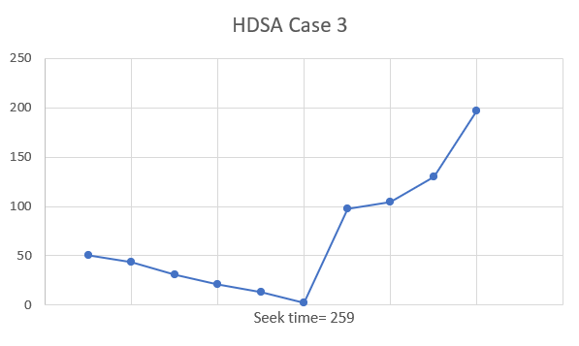
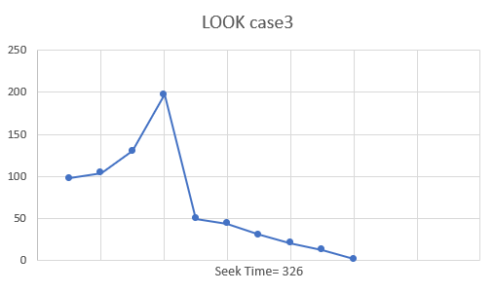

Slide 17
Case 4
Suppose a disk drive has 200 cylinders, numbered 0 to 199. Consider a disk queue with requests for I/o to blocks on cylinder: 176, 79, 34, 60, 92, 11, 41, 114. Assume that disk head is currently at cylinder 50. The figures below show the representation of FCFS, SSTF, SSTF, SCAN, C-SCAN, LOOK, C-LOOK, IFCFS, SMCC and HDSA disk scheduling algorithm

Slide 18
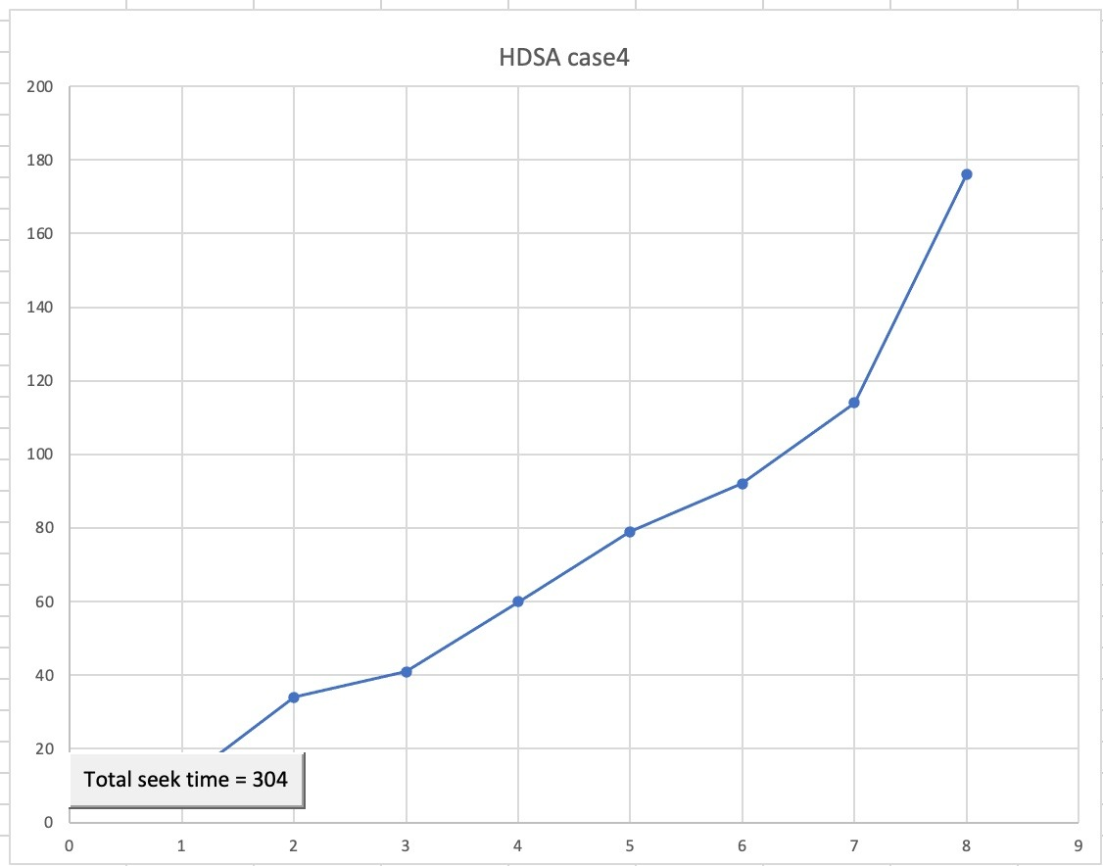
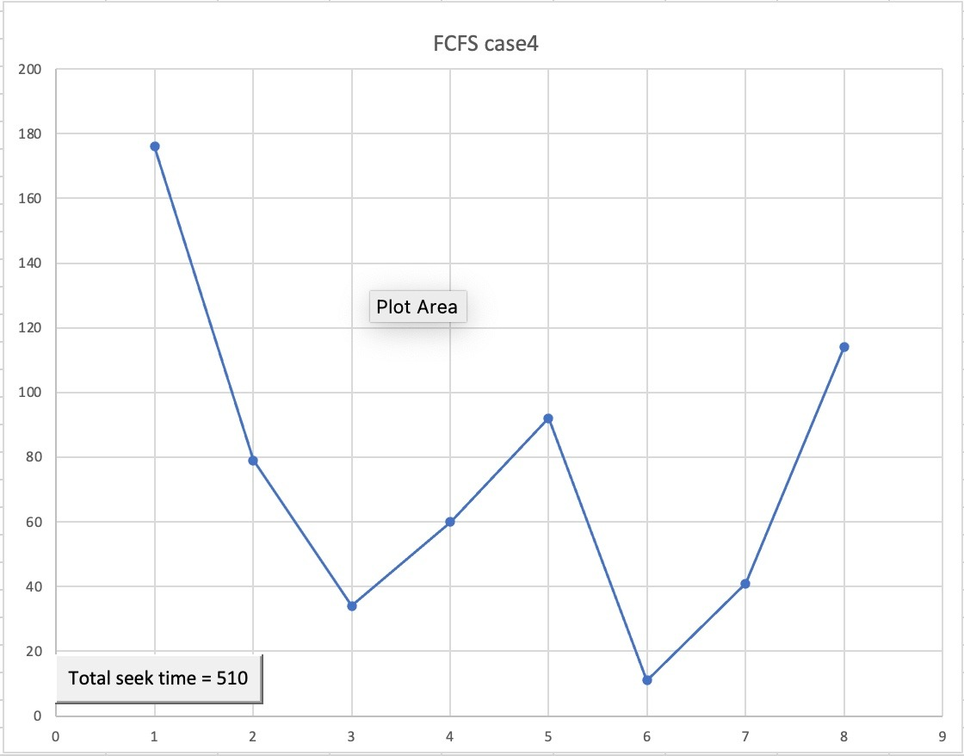
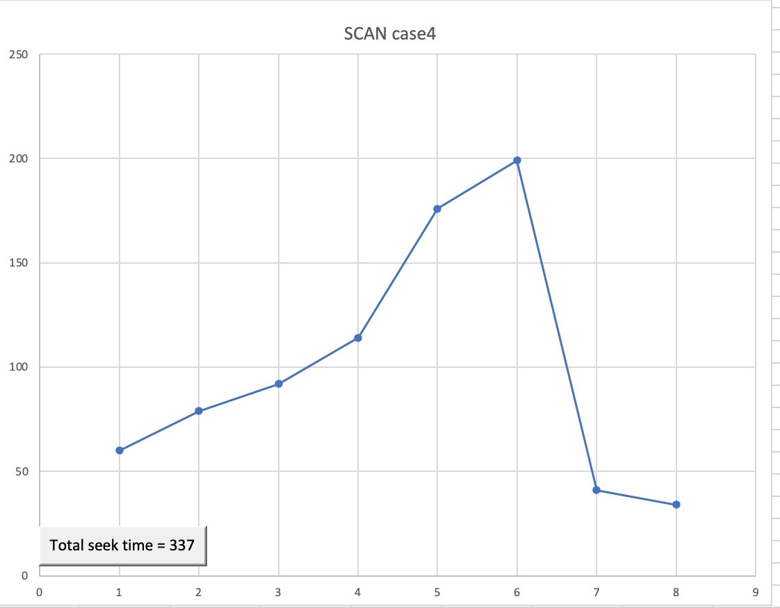
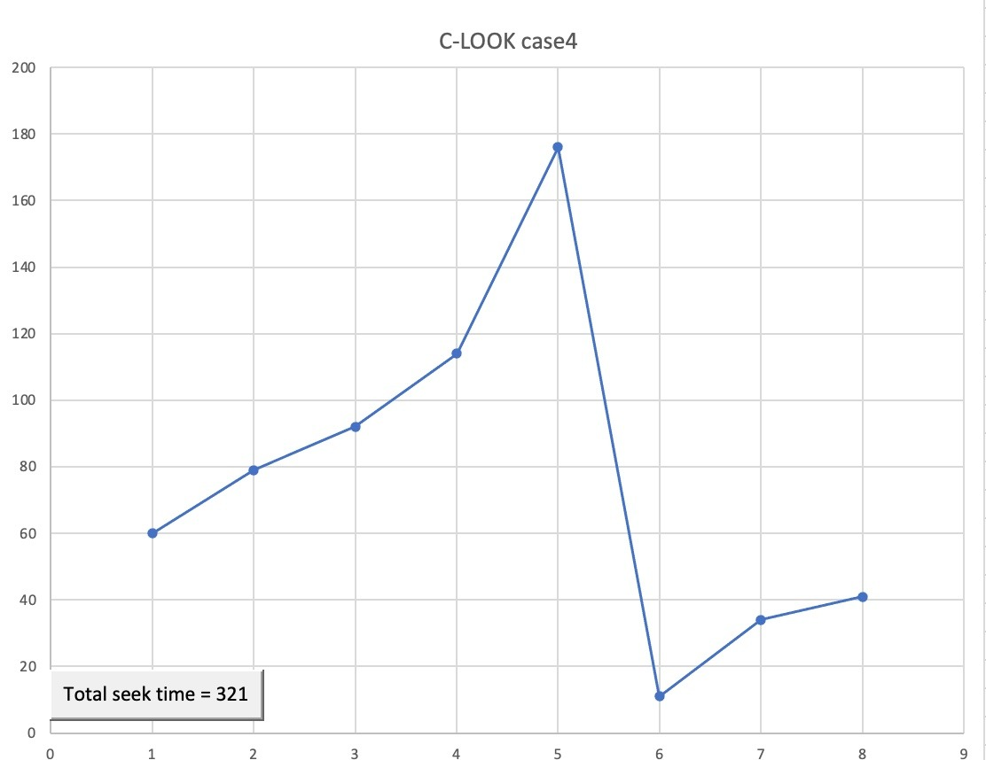
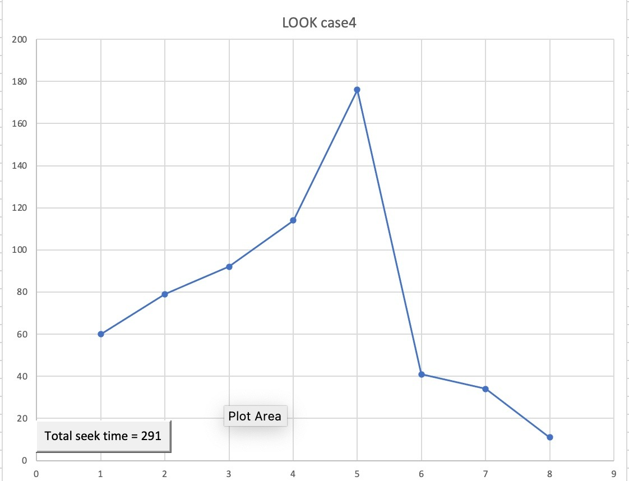
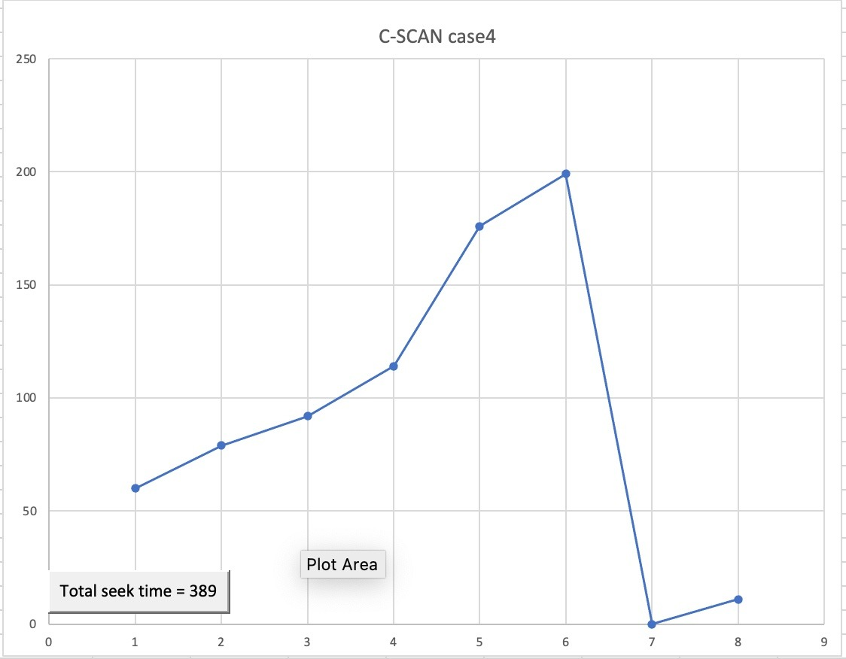
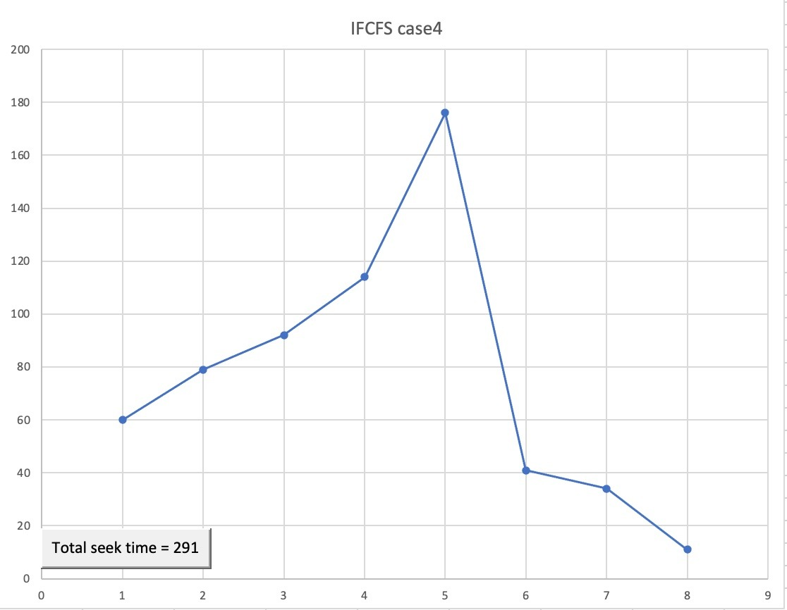
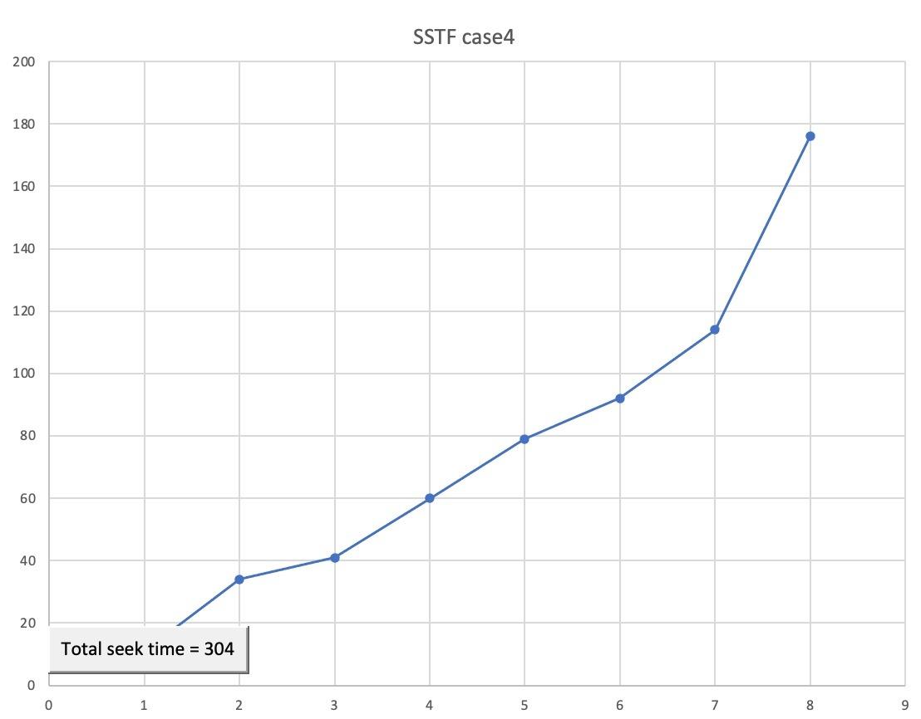
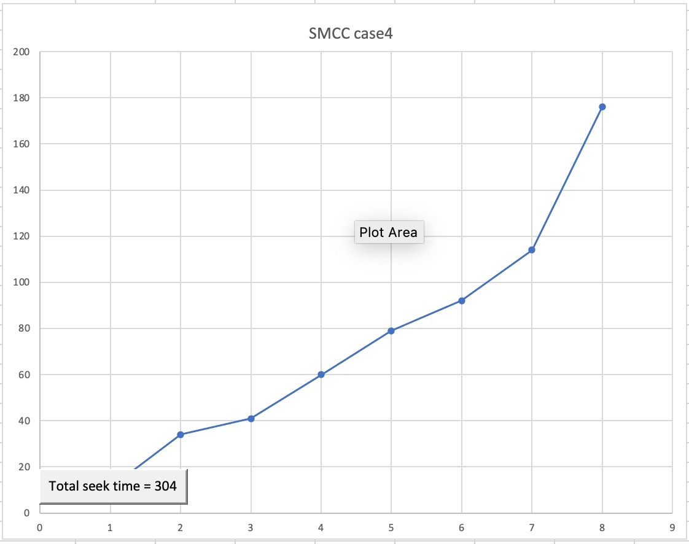

Slide 19
Case 5
Suppose a disk drive has 200 cylinders, numbered 0 to 199. Consider a disk queue with requests for I/o to blocks on cylinder: 50,95, 180, 34, 119, 11, 123, 62, 64. Assume that disk head is currently at cylinder 20. The figures below show show the representation of FCFS, SSTF, SSTF, SCAN, C-SCAN, LOOK, C-LOOK, IFCFS, SMCC and HDSA disk scheduling algorithm Respectively.

Slide 20
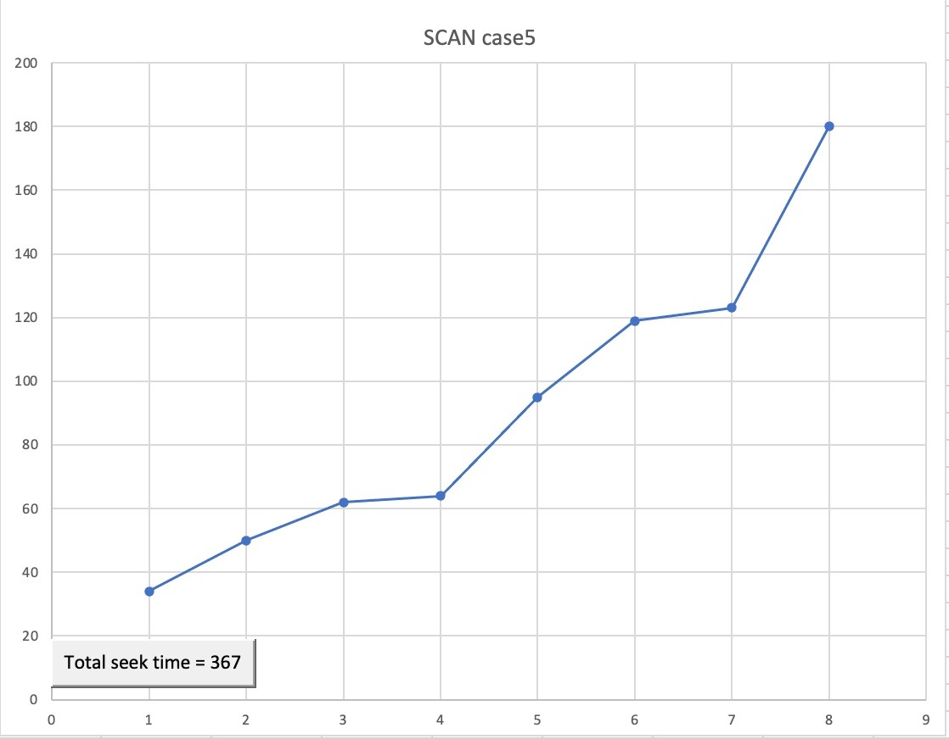
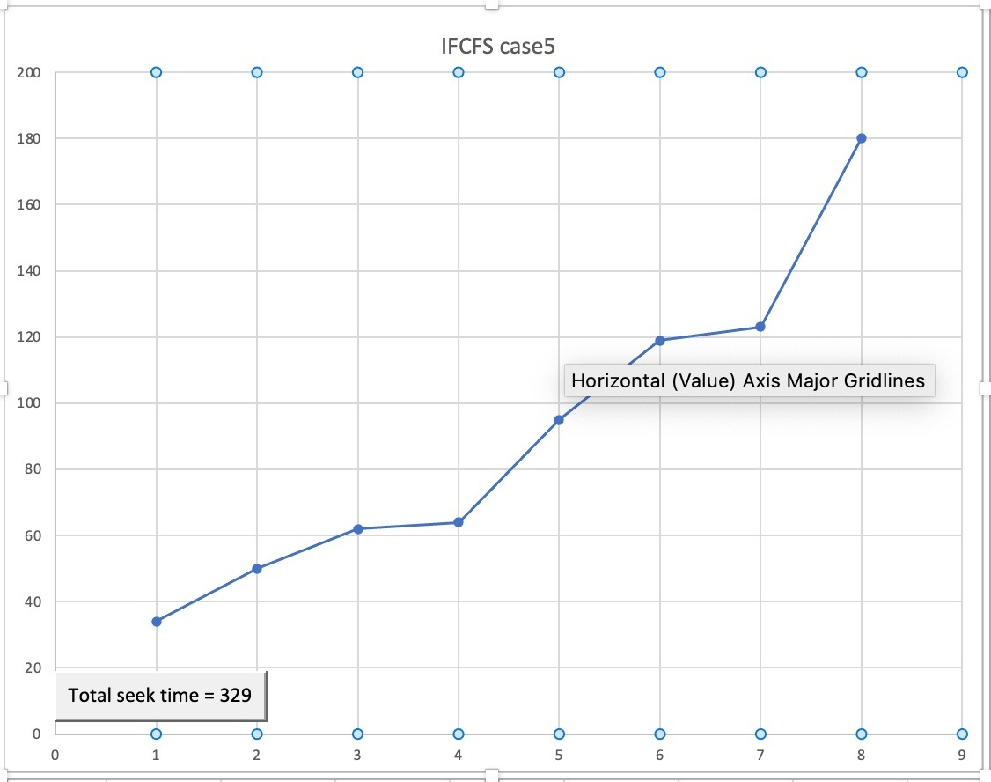

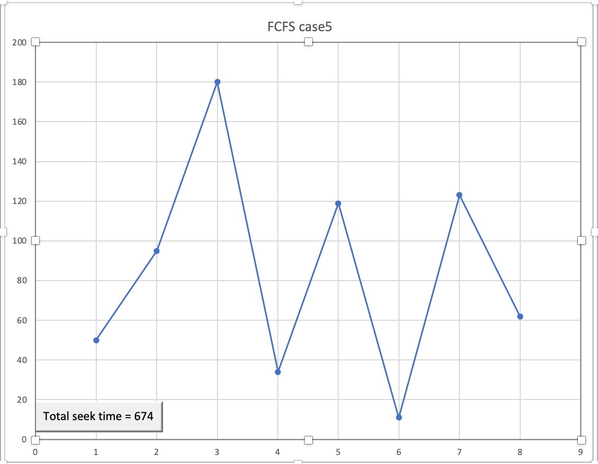
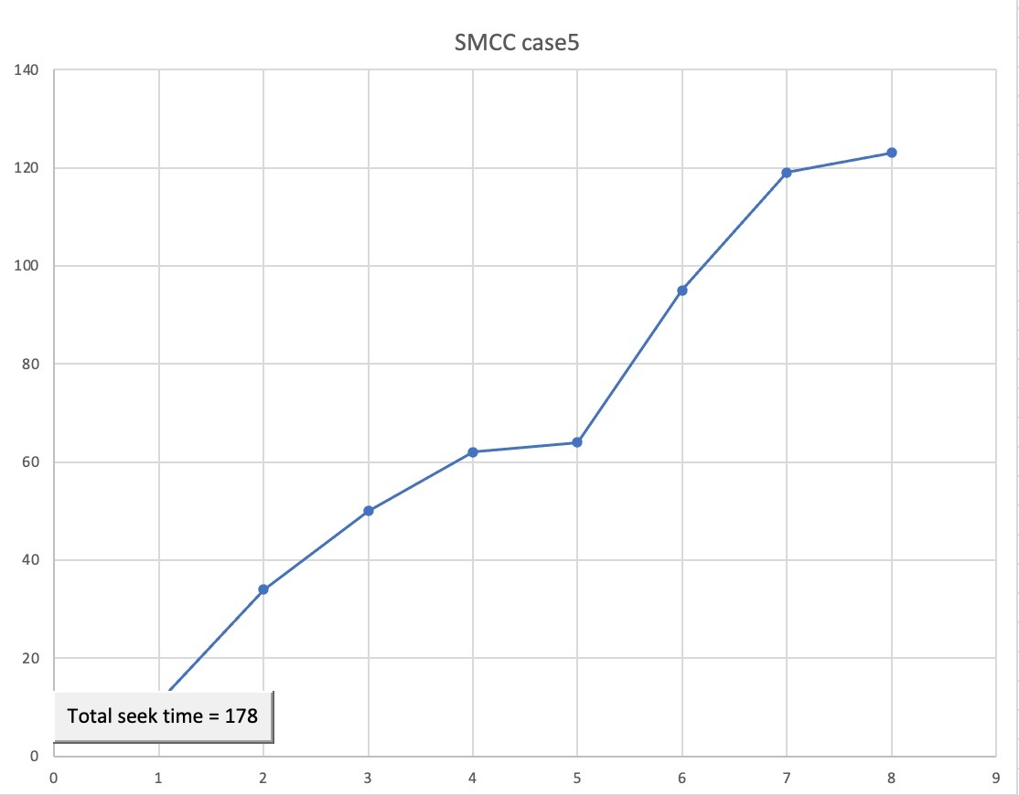
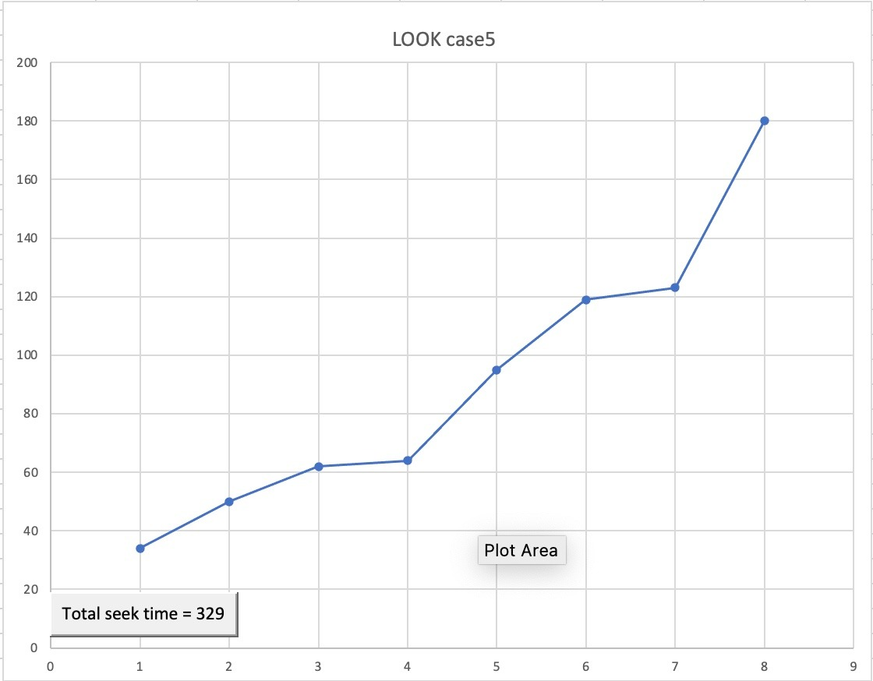
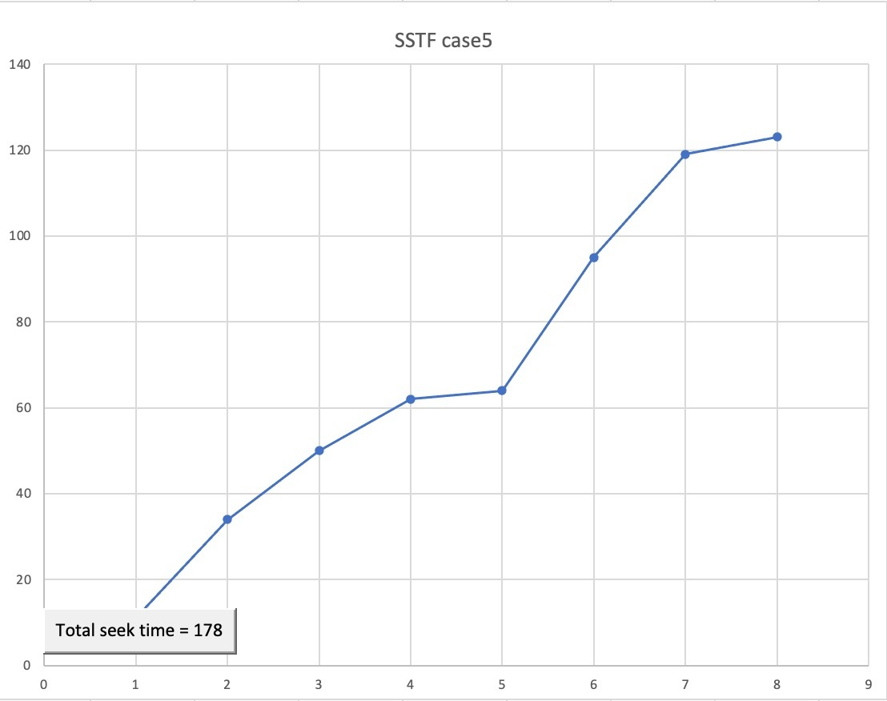
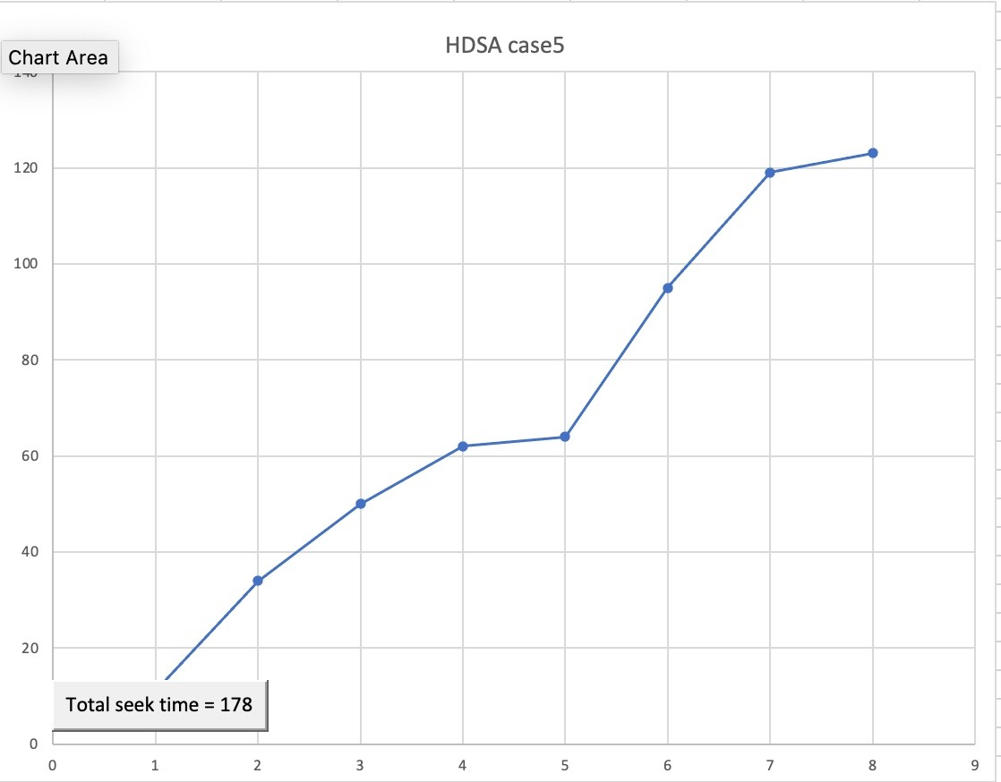
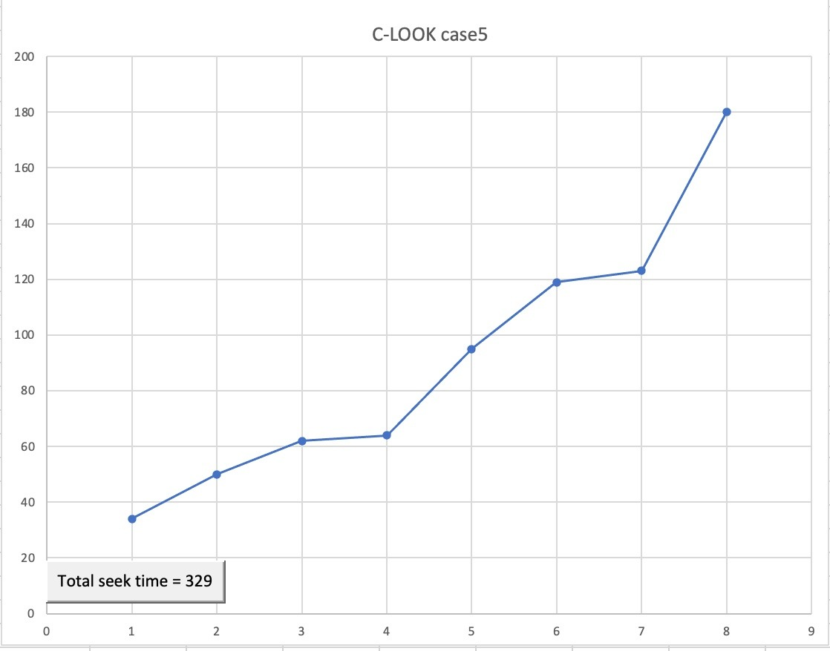

Slide 21
Case 6
Suppose a disk drive has 200 cylinders, numbered 0 to 199. Consider a disk queue with requests for I/o to blocks on cylinder: 95, 180, 34, 119, 11, 123, 62, 64. Assume that disk head is currently at cylinder 50. The figures below show the representation of FCFS, SSTF, SSTF, SCAN, C-SCAN, LOOK, C-LOOK, IFCFS, SMCC and HDSA disk scheduling algorithm.

Slide 22
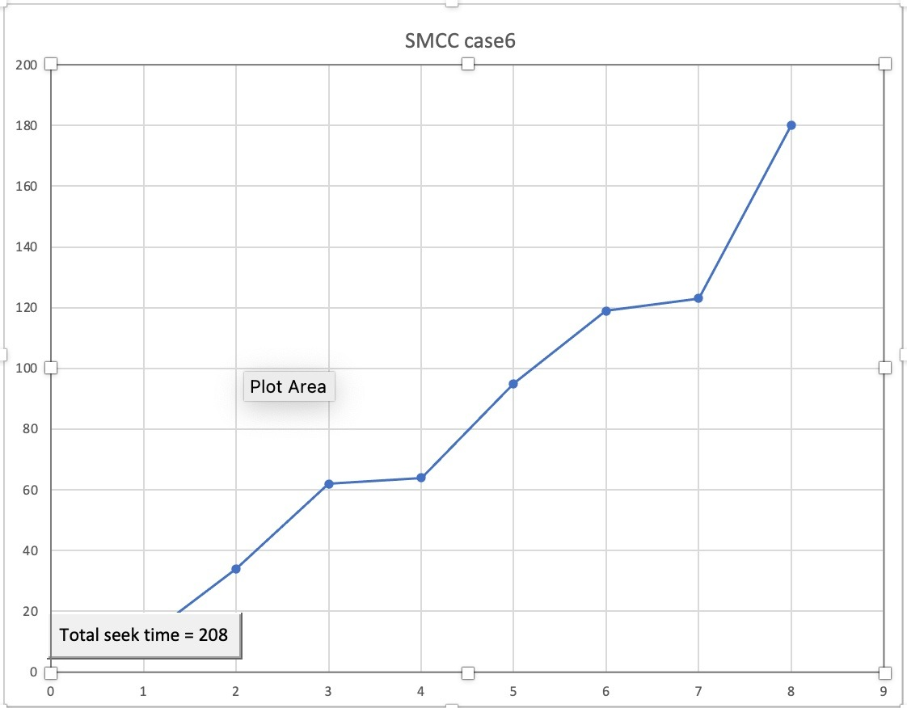
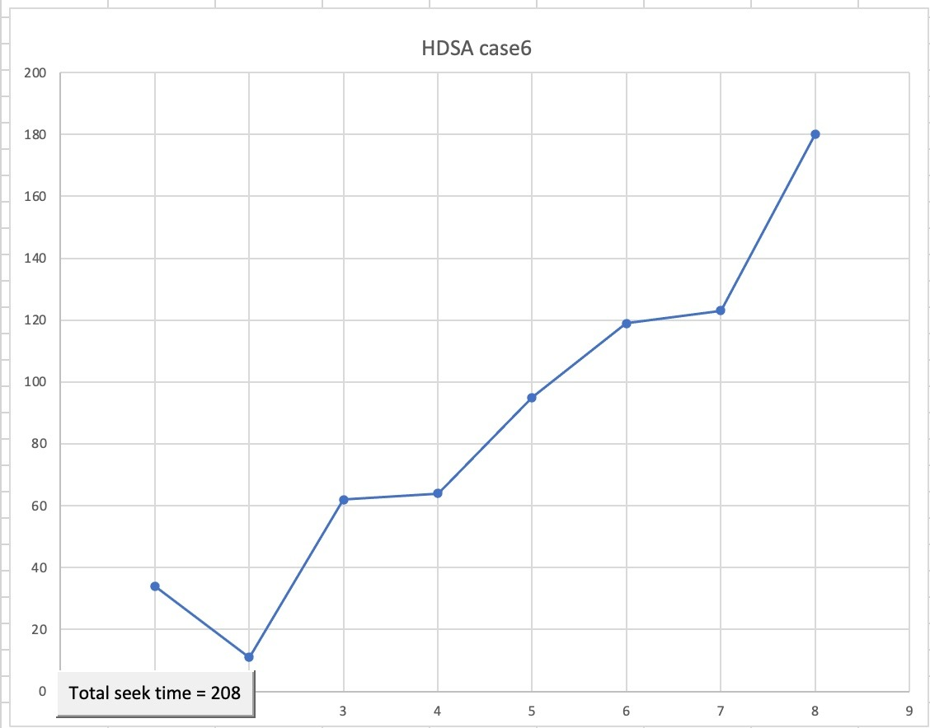
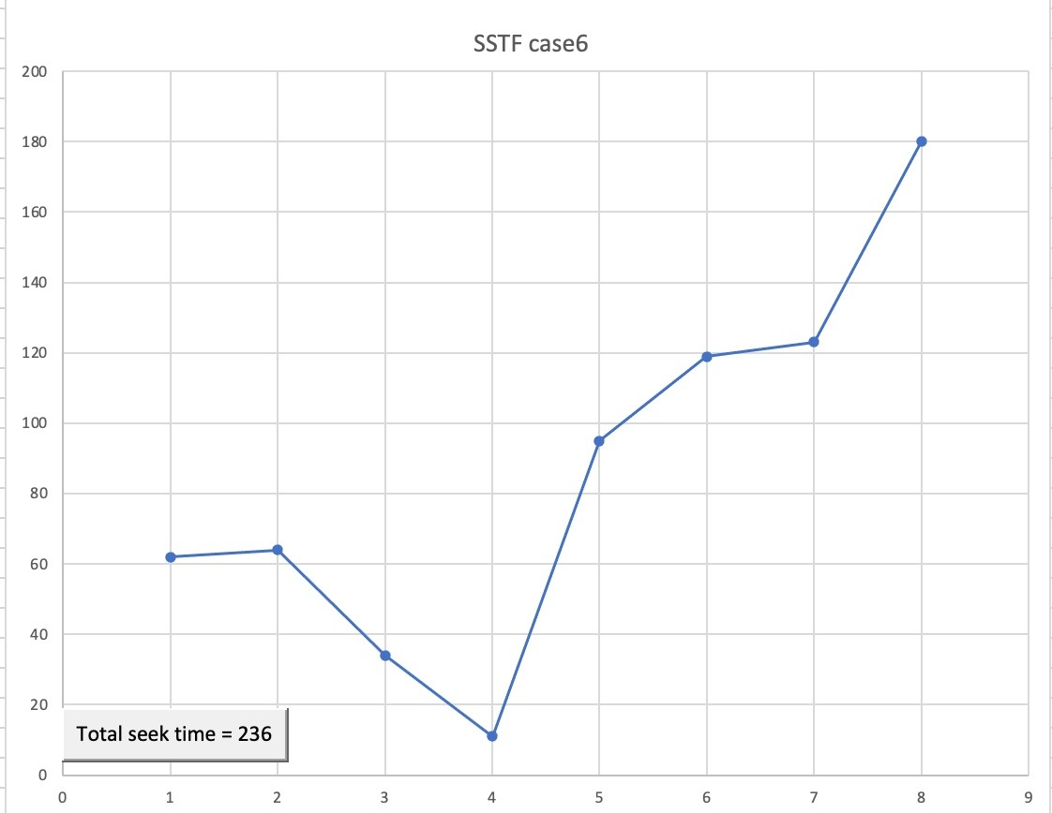
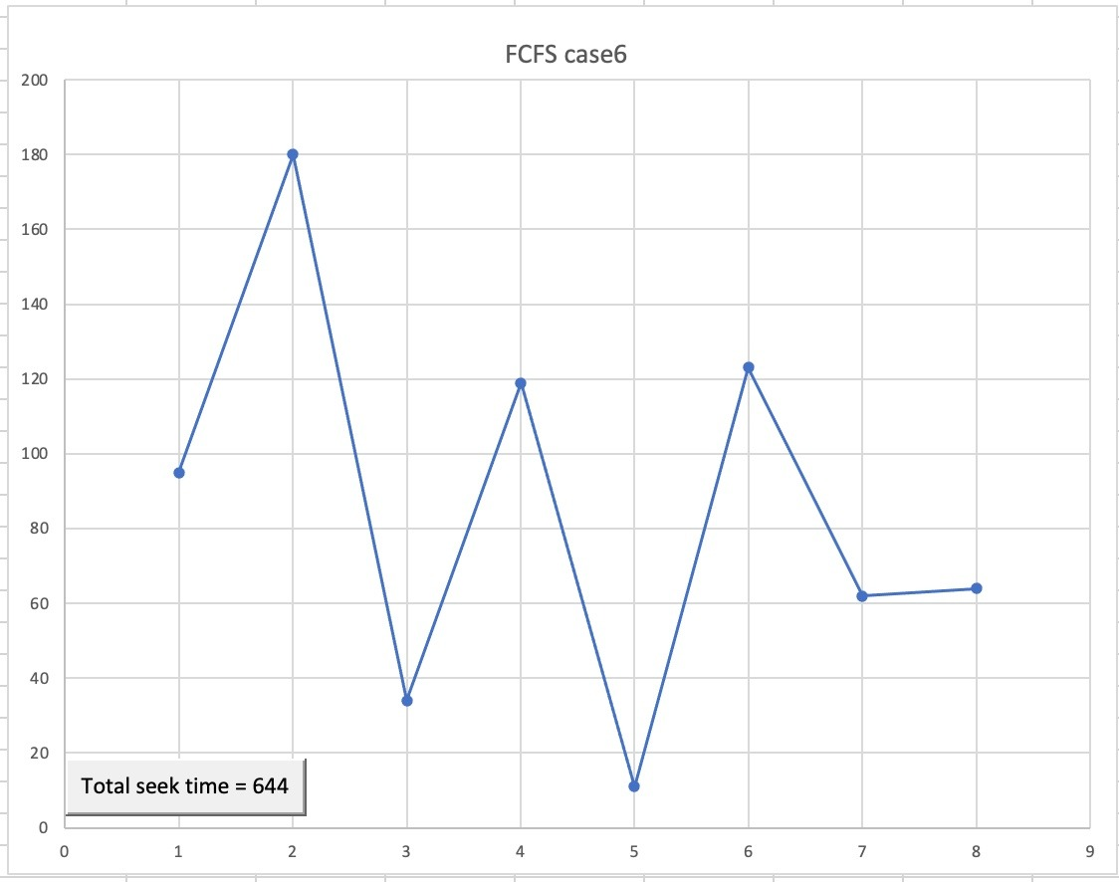
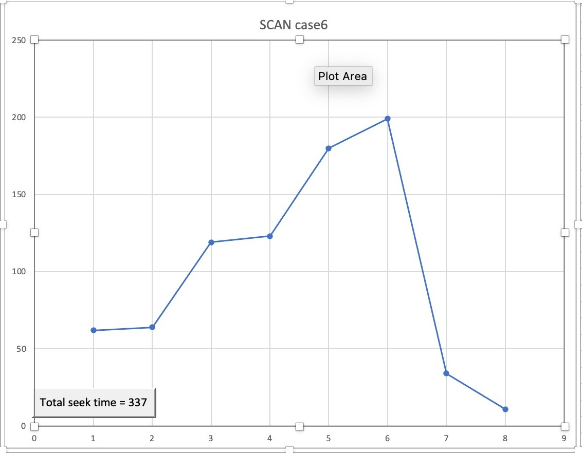





Slide 23
Results and Analysis
Algorithm | CASE 1 | CASE 2 | CASE 3 | CASE 4 | CASE 5 | CASE 6
FCFS | 521 | 517 | 775 | 510 | 674 | 644
SSTF | 254 | 238 | 259 | 204 | 178 | 236
SCAN | 332 | 358 | 330 | 337 | 367 | 337
C-SCAN | 398 | 395 | 382 | 389 | 389 | 382
LOOK | 254 | 268 | 326 | 291 | 329 | 299
C-LOOK | 288 | 285 | 374 | 321 | 329 | 322
IFCFS | 254 | 268 | 259 | 291 | 329 | 299
SMCC | 178 | 164 | 326 | 204 | 178 | 208
HDSA | 178 | 164 | 259 | 204 | 178 | 208

Slide 24

Conclusion
In conclusion, we have implemented 9 algorithms including FCFS, SSTF, SSTF, SCAN, C-SCAN, LOOK, C-LOOK, IFCFS, SMCC and HDSA in C++ programing language. After that we compared between their total seek time. The results indicated that the HDSA algorithm had the best performance in terms of total seek time. We recommend using HDSA algorithm since it had the least total seek time.

